Slide 1
4
INTEGRALS
Copyright © Cengage Learning. All rights reserved.

Slide 2
4.3
Evaluating Definite Integrals
Copyright © Cengage Learning. All rights reserved.

Slide 3

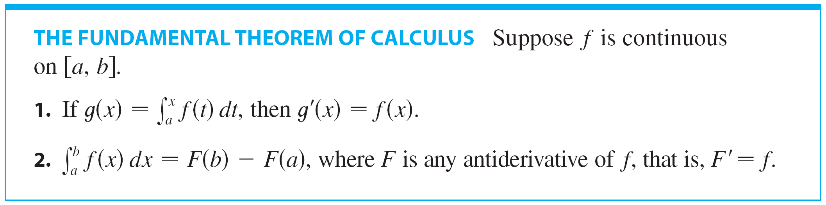
Evaluating Definite Integrals
Sir Isaac Newton and Leibniz realized that they could calculate f(x)dx if they happened to know an antiderivative F of f. Their discovery, called the Evaluation Theorem, is part 2 of the Fundamental Theorem of Calculus.

Slide 4
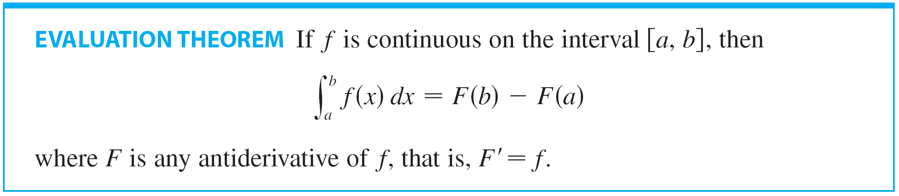
Evaluating Definite Integrals
The Evaluation Theorem is as follows:
This theorem states that if we know an antiderivative F of f,
then we can evaluate f (x) dx simply by subtracting the
values of F at the endpoints of the interval [a, b].

Slide 5
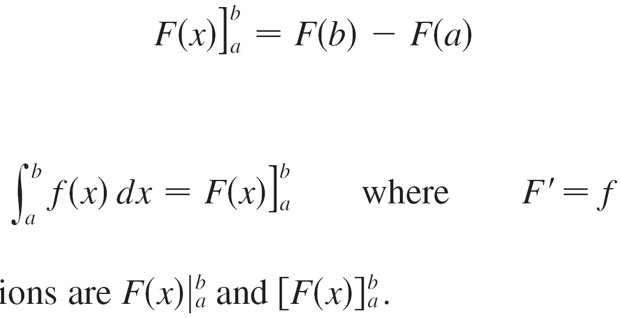
Evaluating Definite Integrals
It is very surprising that f (x) dx, which was defined by a complicated procedure involving all of the values of f (x) for a ≤ x ≤ b, can be found by knowing the values of F(x) at only two points, a and b.
When applying the Evaluation Theorem we use the
notation
and so we can write
where
Other common notations are and .

Slide 6
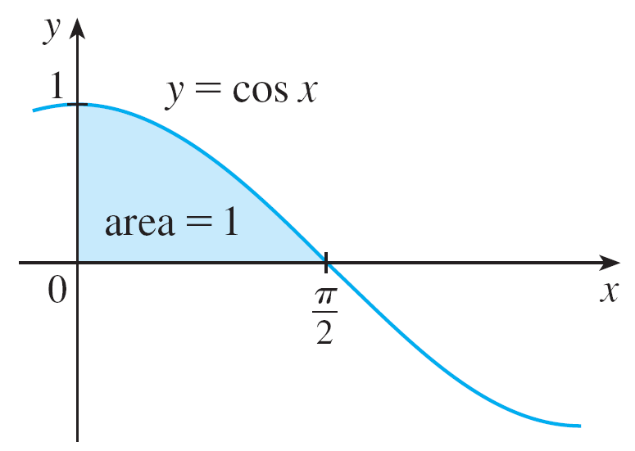
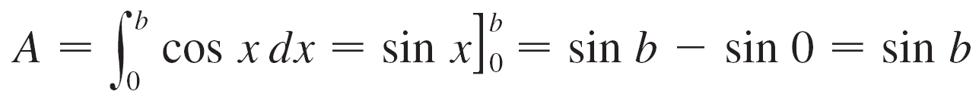
Example 1
Find the area under the cosine curve from 0 to b, where
0 ≤ b ≤ π /2.
Solution:
Since an antiderivative of is we have
In particular, taking b = π /2, we have proved that the area under the cosine curve from 0 to π /2 is sin(π /2) = 1.
(See Figure 1.)

Slide 7
Indefinite Integrals

Slide 8
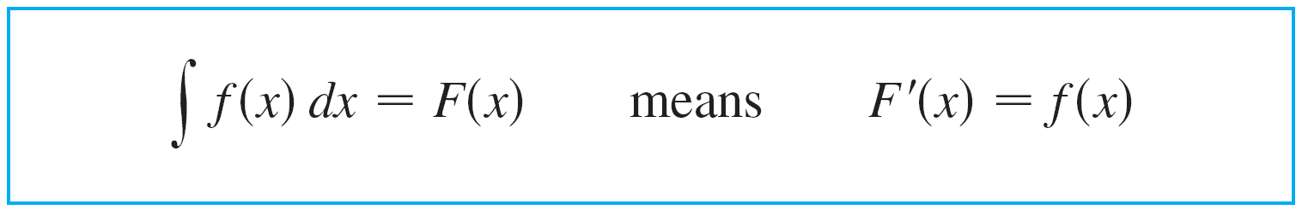
Indefinite Integrals
The notation f (x) dx is traditionally used for an antiderivative of f and is called an indefinite integral.
Thus
An indefinite integral f (x) dx can represent either a particular antiderivative of f or an entire family of antiderivatives (one for each value of the constant C).

Slide 9
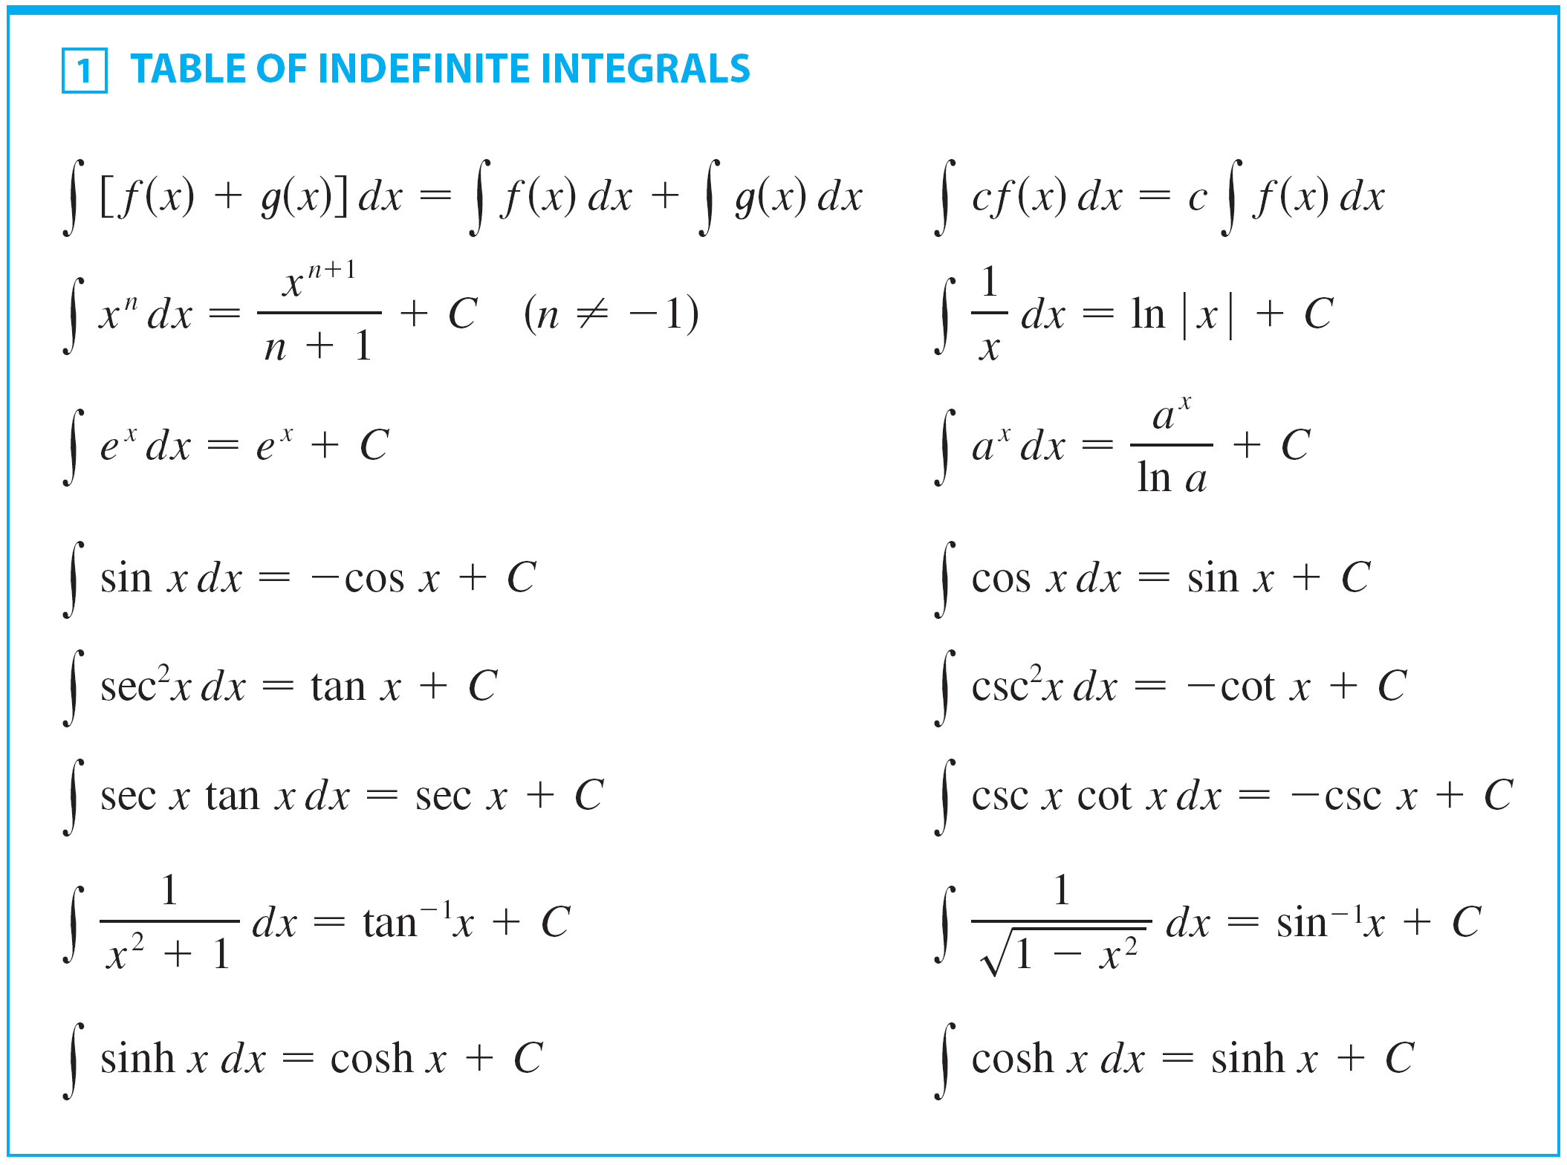
Indefinite Integrals
A Table of Antidifferentiation Formulas follows:

Slide 10
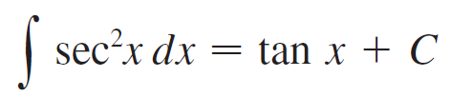
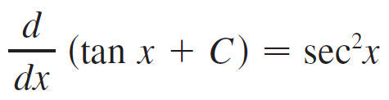
Indefinite Integrals
Any formula can be verified by differentiating the function on the right side and obtaining the integrand. For instance,
because

Slide 11

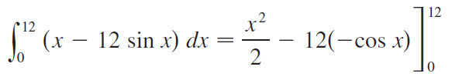



Example 5
Find
Solution:
The Fundamental Theorem gives

Slide 12
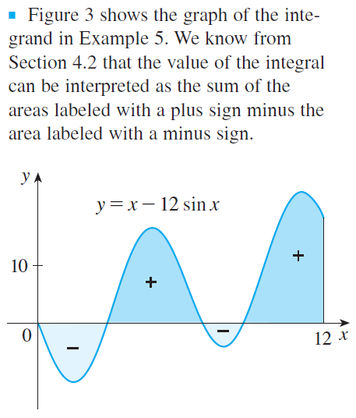

Example 5 – Solution
cont’d
We know that this is the exact value of the integral. If a decimal approximation is desired, use a calculator to approximate cos 12. Doing so, we get
Figure 3

Slide 13
Applications

Slide 14
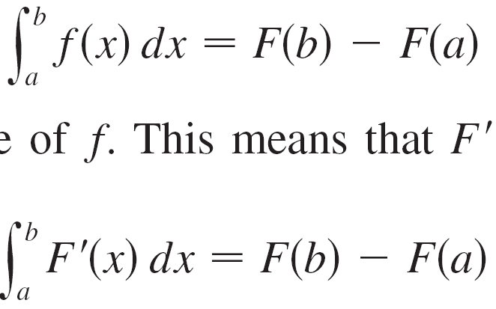
Applications
The Evaluation Theorem says that if f is continuous on
[a, b], then
where F is any antiderivative of f. This means that F′ = f, so the equation can be rewritten as

Slide 15

Applications
We know that F′(x) represents the rate of change of
y = F(x) with respect to x and F(b) – F(a) is the change in y when x changes from a to b.
[Note that y could, for instance, increase, then decrease, then increase again. Although y might change in both directions, F(b) – F(a) represents the net change in y.]
So we can reformulate the Evaluation Theorem in words as follows.

Slide 16
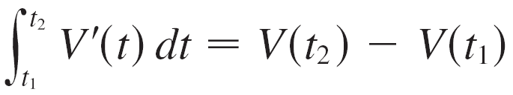
Applications
This principle can be applied to all of the rates of change in the natural and social sciences. Here are a few instances of this idea:
If V(t) is the volume of water in a reservoir at time t, then
its derivative V′(t) is the rate at which water flows into the
reservoir at time t.
So
is the change in the amount of water in the reservoir
between time t₁ and time t₂.

Slide 17
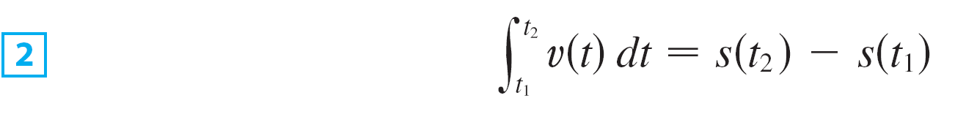
Applications
If an object moves along a straight line with position
function s(t), then its velocity is v(t) = s′(t), so
is the net change of position, or displacement, of the
particle during the time period from t₁ to t₂.

Slide 18
Example 7
A particle moves along a line so that its velocity at time t is
v(t) = t² – t – 6 (measured in meters per second).
(a) Find the displacement of the particle during the time period 1 ≤ t ≤ 4.
(b) Find the distance traveled during this time period.

Slide 19
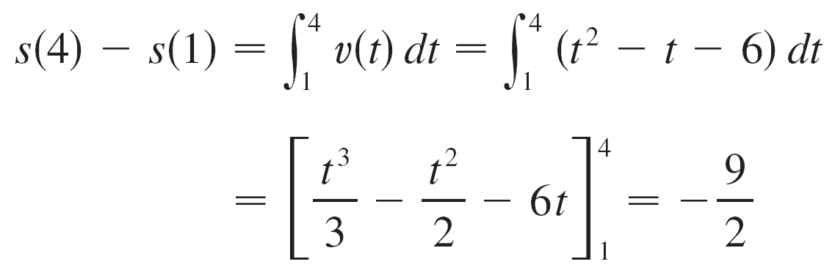
Example 7(a) – Solution
By Equation 2, the displacement is
This means that the particle’s position at time t = 4 is 4.5 m to the left of its position at the start of the time period.

Slide 20
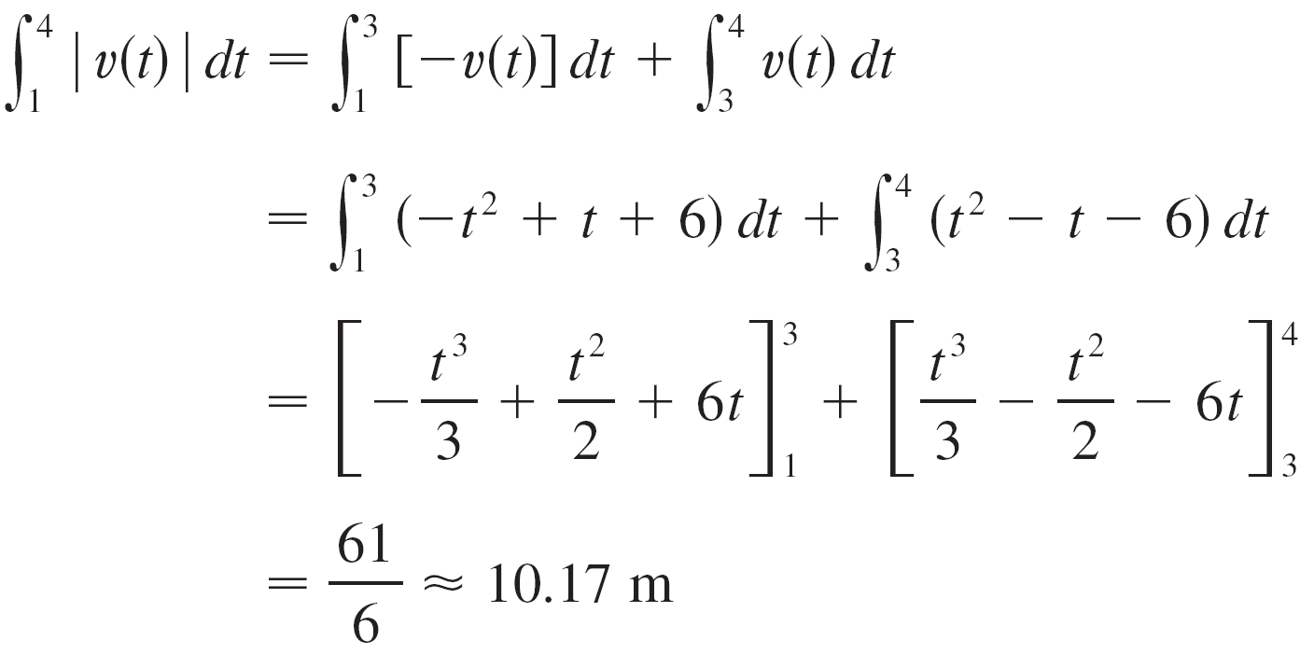
Example 7(b) – Solution
cont’d
Note that v(t) = t² – t – 6 = (t – 3) (t + 2) and so v(t) ≤ 0 on the interval [1, 3] and v(t) ≥ 0 on [3, 4].
Thus, from Equation 3, the distance traveled is

Slide 21
4.4
The Fundamental Theorem of Calculus
Copyright © Cengage Learning. All rights reserved.

Slide 22

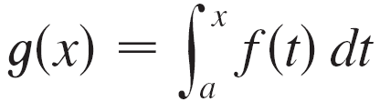
The Fundamental Theorem of Calculus
The Fundamental Theorem of Calculus gives the precise inverse relationship between the derivative and the integral.
The first part of the Fundamental Theorem deals with functions defined by an equation of the form
where f is a continuous function on [a, b] and x varies between a and b.

Slide 23
The Fundamental Theorem of Calculus
Observe that g depends only on x, which appears as the variable upper limit in the integral.
If x is a fixed number, then the integral is a definite number.
If we then let x vary, the number also varies and defines a function of x denoted by g(x).

Slide 24
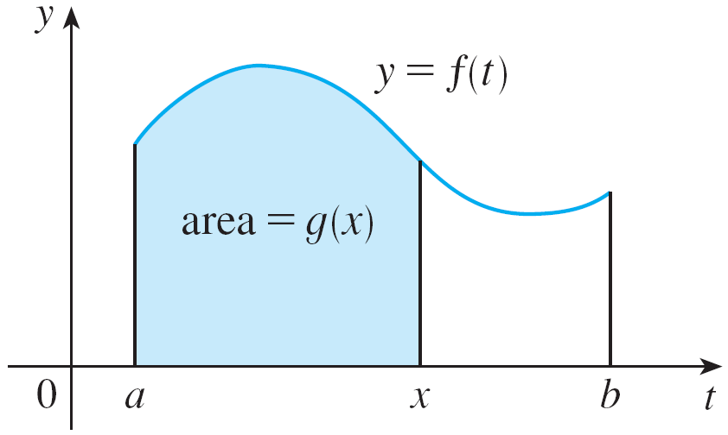
The Fundamental Theorem of Calculus
If f happens to be a positive function, then g(x) can be interpreted as the area under the graph f of from a to x, where x can vary from a to b.
(Think of g as the “area so far” function; see Figure 1.)
Figure 1

Slide 25

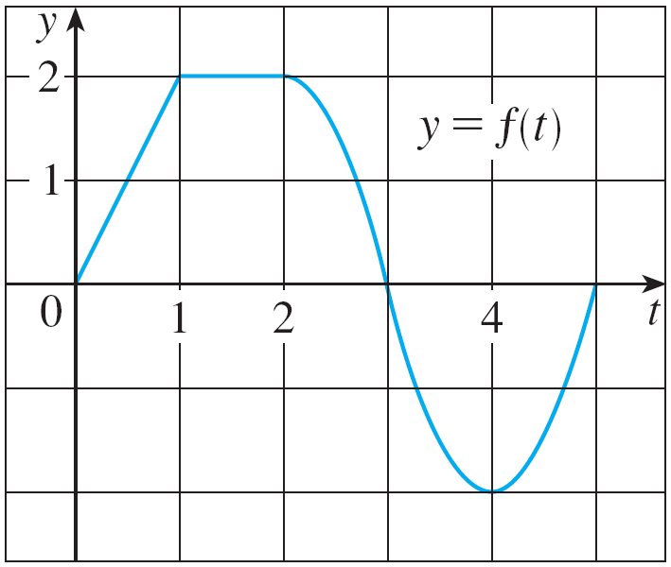
Example 1
If f is the function whose graph is shown in Figure 2 and
, find the values of g(0), g(1), g(2), g(3), g(4), and g(5).
Then sketch a rough graph of g.
Figure 2

Slide 26

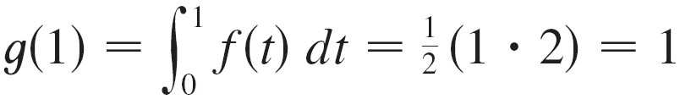
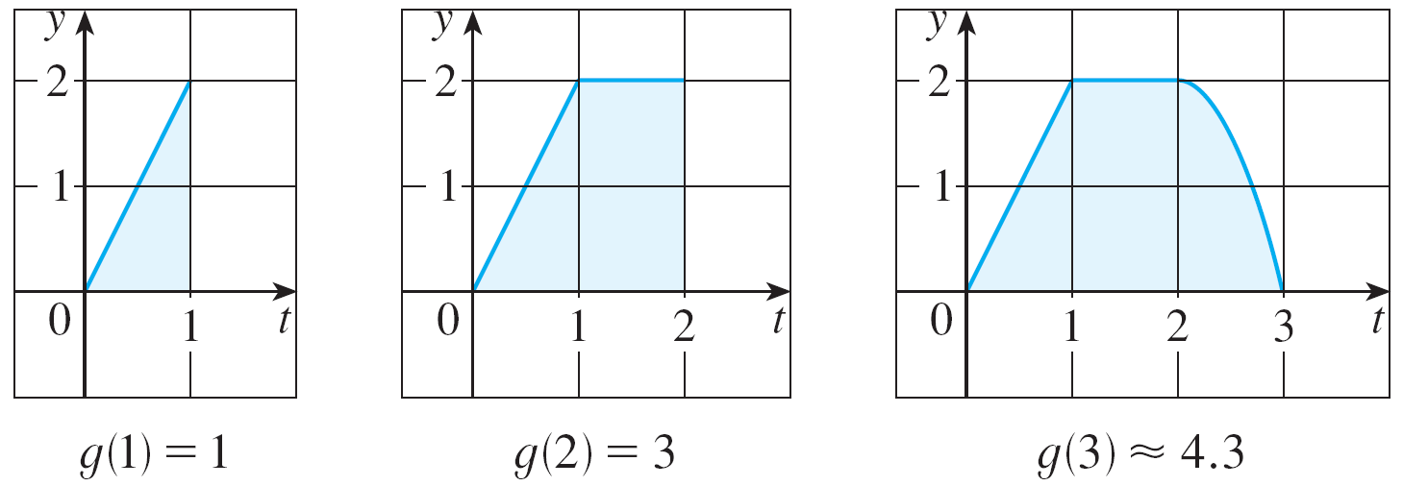
Example 1 – Solution
First we notice that
From Figure 3 we see that g(1) is the area of a triangle:
Figure 3

Slide 27
Example 1 – Solution
cont’d
To find g(2) we add to g(1) the area of a rectangle:
Figure 3

Slide 28
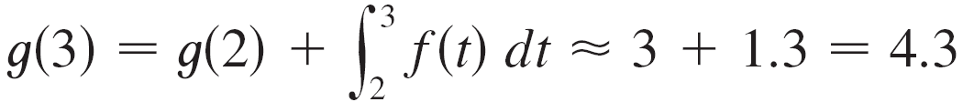
Example 1 – Solution
cont’d
We estimate that the area under f from 2 to 3 is about 1.3, so
Figure 3

Slide 29
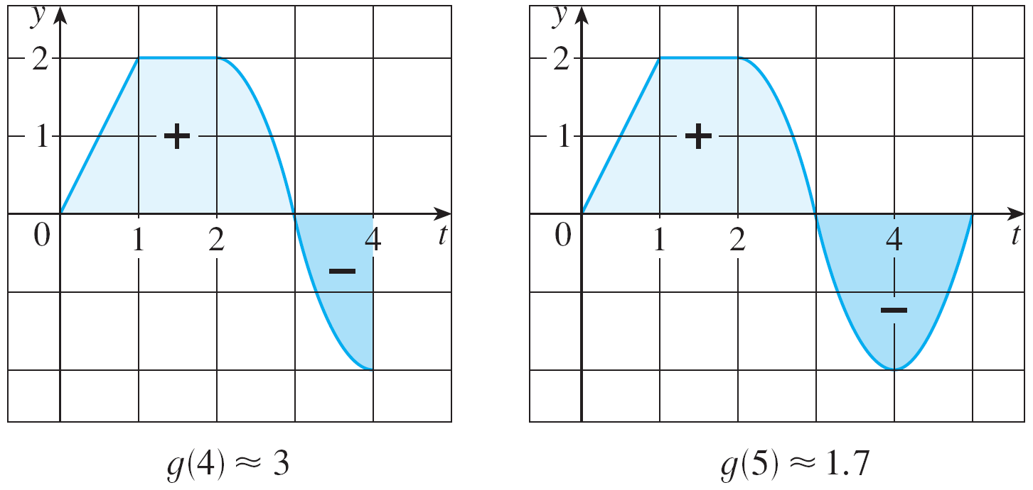
Example 1 – Solution
cont’d
For t > 3, f (t) is negative and so we start subtracting areas:
Figure 3

Slide 30
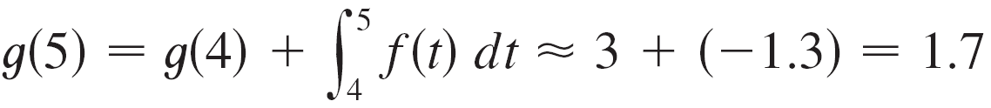
Example 1 – Solution
cont’d
Figure 3

Slide 31
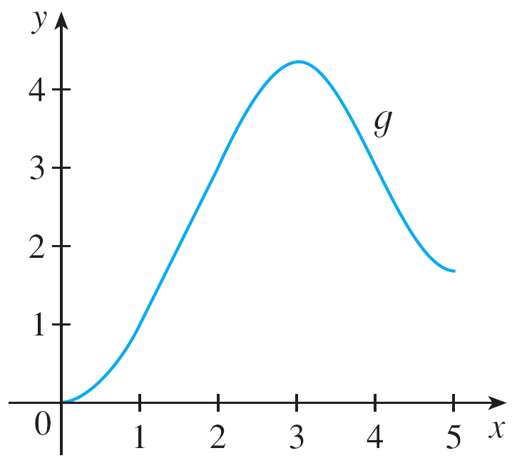
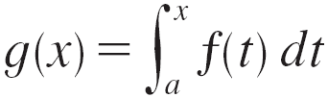
Example 1 – Solution
cont’d
We use these values to sketch the graph of g in Figure 4.
Notice that, because f (t) is positive for t < 3, we keep adding area for t < 3 and so g is increasing up to x = 3, where it attains a maximum value.
For x > 3, g decreases because f (t) is negative.
Figure 4

Slide 32


The Fundamental Theorem of Calculus
If g is defined as the integral of f by Equation 1, then g turns out to be an antiderivative of f. Hence g’ = f.
To see why this might be generally true we consider
any continuous function f with
Then can be
interpreted as the area under
the graph of f from a to x, as in
Figure 1.
Figure 1

Slide 33
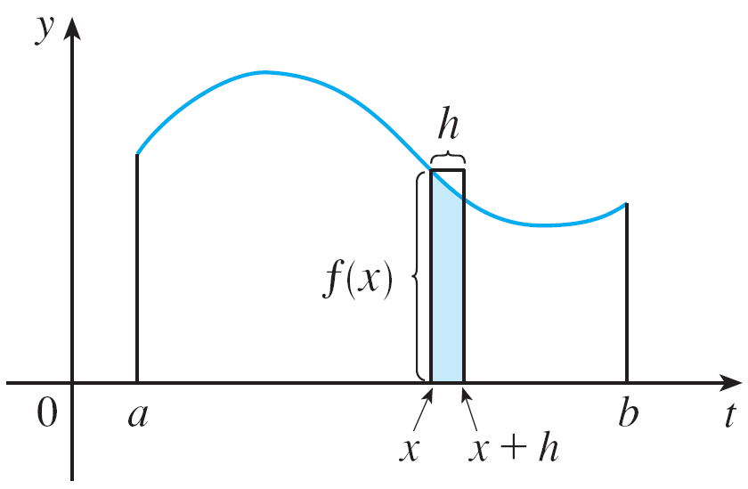
The Fundamental Theorem of Calculus
In order to compute g ′(x) from the definition of derivative we first observe that, for h > 0, g(x + h) – g(x) is obtained by subtracting areas, so it is the area under the graph of f from x to x + h (the shaded area in Figure 5).
Figure 5

Slide 34
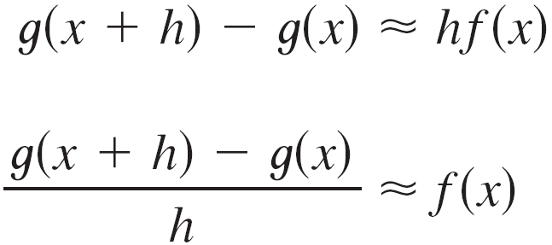
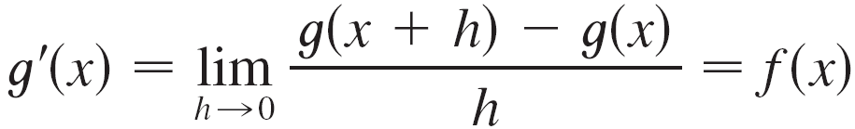
The Fundamental Theorem of Calculus
For small h you can see from the figure that this area is approximately equal to the area of the rectangle with height f (x) and width h:
so
Intuitively, we therefore expect that

Slide 35
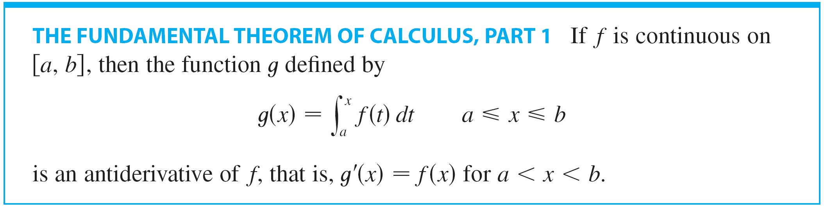
The Fundamental Theorem of Calculus
The fact that this is true, even when f is not necessarily positive, is the first part of the Fundamental Theorem of Calculus.

Slide 36
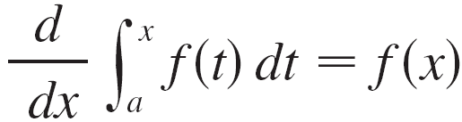
The Fundamental Theorem of Calculus
Using Leibniz notation for derivatives, we can write FTC1 as
when f is continuous.
Roughly speaking, this equation says that if we first integrate f and then differentiate the result, we get back to the original function f.

Slide 37
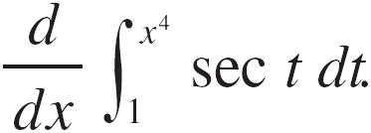
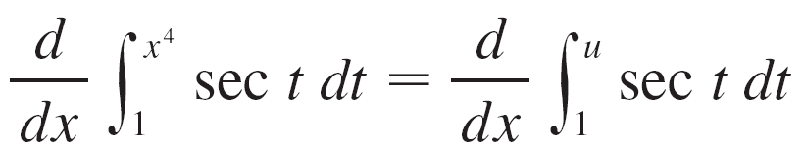

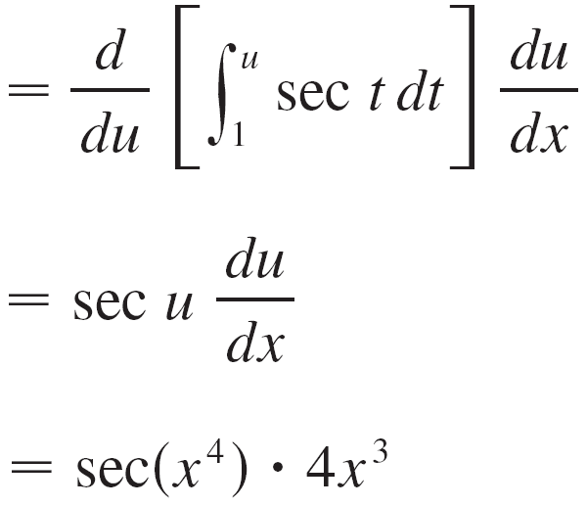


Example 5
Find
Solution:
Here we have to be careful to use the Chain Rule in conjunction with Part 1 of the Fundamental Theorem.
Let Then

Slide 38
Differentiation and Integration as Inverse Processes

Slide 39
Differentiation and Integration as Inverse Processes
We now bring together the two parts of the Fundamental Theorem. We regard Part 1 as fundamental because it relates integration and differentiation.
But the Evaluation Theorem also relates integrals and derivatives, so we rename it as Part 2 of the Fundamental Theorem.

Slide 40


Differentiation and Integration as Inverse Processes
We noted that Part 1 can be written as
which says that if f is integrated and the result is differentiated, we arrive back at the original function f. In Section 4.3 we reformulated Part 2 as the Net Change Theorem:

Slide 41
Differentiation and Integration as Inverse Processes
This version says that if we take a function F, first differentiate it, and then integrate the result, we arrive back at the original function F, but in the form F(b) – F(a).
Taken together, the two parts of the Fundamental Theorem of Calculus say that differentiation and integration are inverse processes. Each undoes what the other does.

Slide 42
Average Value of a Function

Slide 43
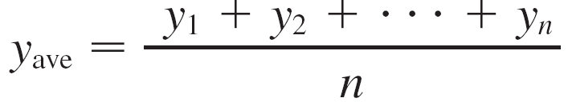
Average Value of a Function
It’s easy to calculate the average value of finitely many numbers y₁, y₂, . . . , y_{n}:
But how do we compute the average temperature during a day if infinitely many temperature readings are possible?

Slide 44
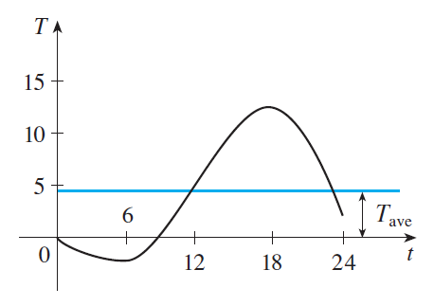
Average Value of a Function
Figure 9 shows the graph of a temperature function T(t), where t is measured in hours and T in °C, and a guess at the average temperature, T_{ave}.
Figure 9

Slide 45


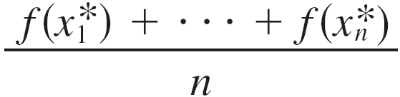
Average Value of a Function
In general, let’s try to compute the average value of a function y= f(x), a ≤ x ≤ b.
We start by dividing the interval [a, b] into n equal subintervals, each with length ∆x = (b – a) / n.
Then we choose points in successive subintervals and calculate the average of the numbers

Slide 46


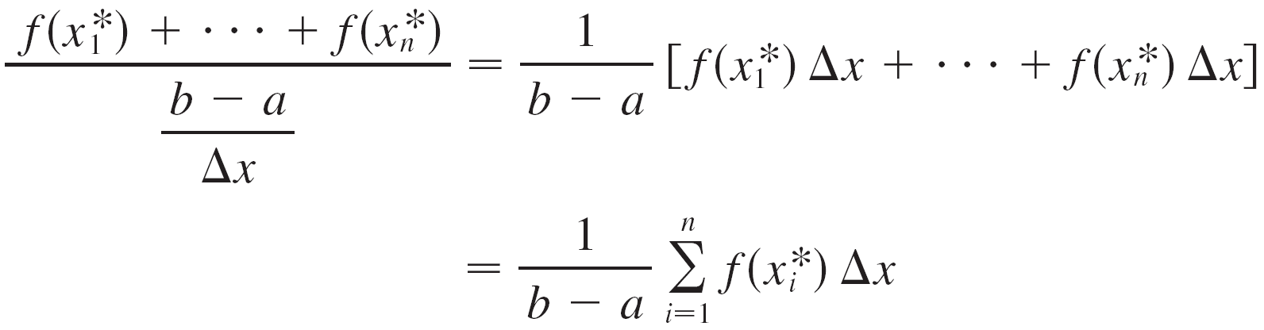
Average Value of a Function
Since we can write and the average value becomes

Slide 47
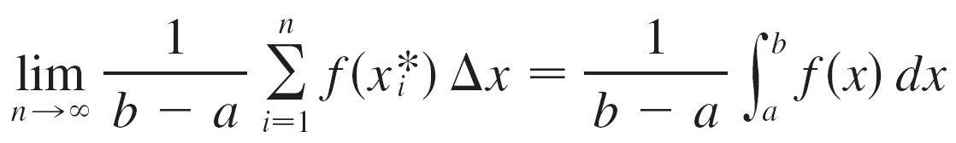
Average Value of a Function
If we let n increase, we would be computing the average value of a large number of closely spaced values.
The limiting value is
by the definition of a definite integral.

Slide 48
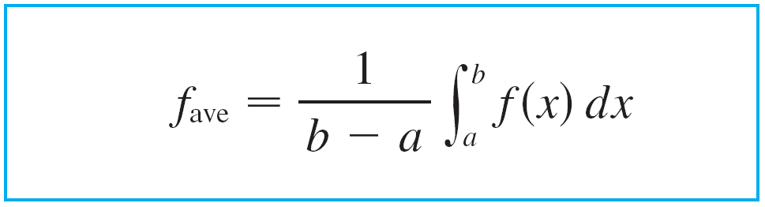
Average Value of a Function
Therefore, we define the average value of f on the interval [a, b] as

Slide 49

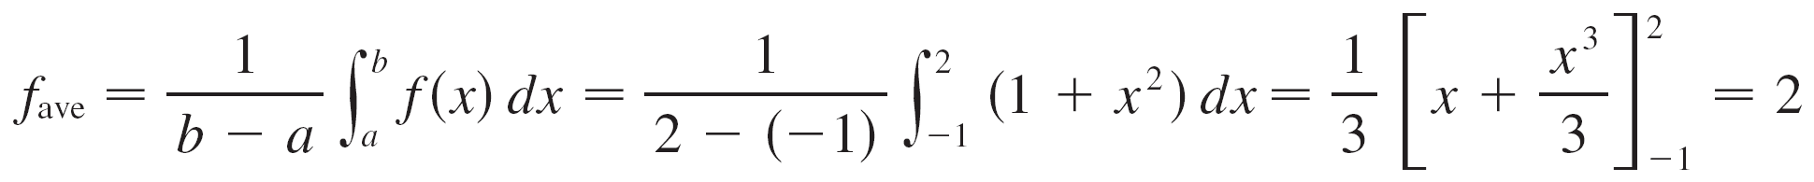
Example 6
Find the average value of the function on the interval [–1, 2].
Solution:
With a = –1 and b = 2 we have

Slide 50
Average Value of a Function
If T(t) is the temperature at time t, we might wonder if there is a specific time when the temperature is the same as the average temperature. For the temperature function graphed in Figure 9, we see that there are two such times—just before noon and just before midnight.
Figure 9

Slide 51
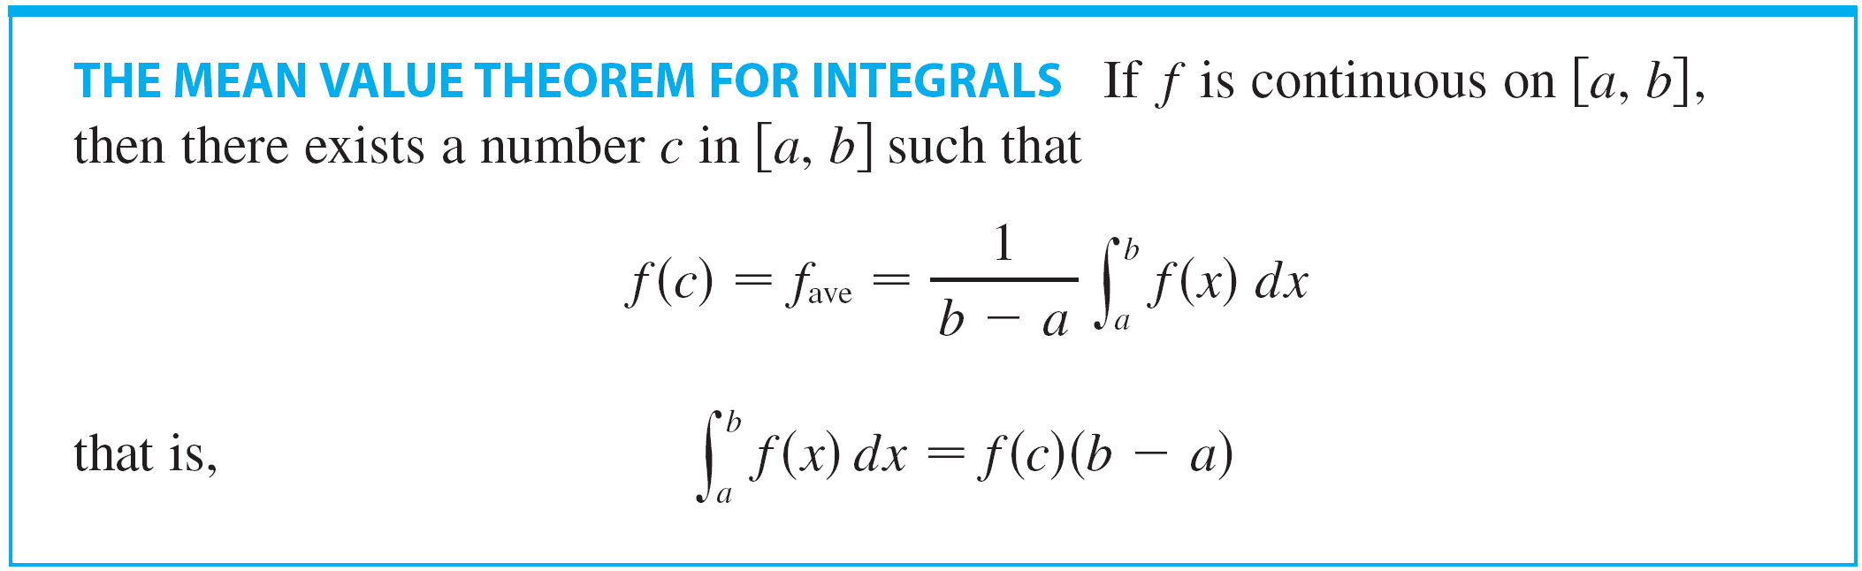
Average Value of a Function
In general, is there a number c at which the value of a function f is exactly equal to the average value of the function, that is, f(c) = f_{ave}?
The following theorem says that this is true for continuous functions.

Slide 52
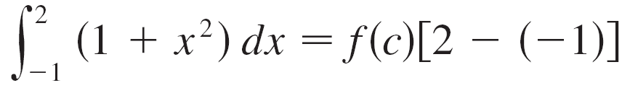


Example 7
Since is continuous on the interval [–1, 2], the Mean Value Theorem for Integrals says there is a number c in [–1, 2] such that
In this particular case we can find c explicitly.
From Example 6 we know that so the value of c satisfies

Slide 53


Example 7
cont’d
Therefore
so
Thus in this case there happen to be two numbers c = ±1 in the interval [–1, 2] that work in the Mean Value Theorem for Integrals.

Slide 54
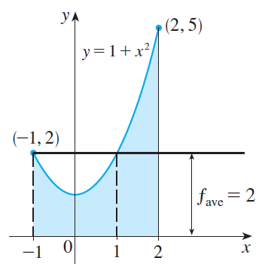
Example 7
cont’d
Examples 6 and 7 are illustrated by Figure 11.
Figure 11

